Slide 1
Reputation Management
Group 4
Daisy Dunn - Isabella Novati - Jennifer Rafferty - Maryam Umar - Emma Diederik

Slide 2
AGENDA
Introduction
Importance of reputation
Importance of stakeholders
The Volkswagen Dieselgate scandal /Activity
Fake News
Astroturfing
Measuring reputation
Activity
Team

Slide 3
INTRODUCTION
CORPORATE
IMAGE
Is the set of meanings by which an object is known and through which people describe, remember and relate to it (Dowling, 2014)
CORPORATE
IDENTITY
The distinctive public image that an organisation communicates that influences stakeholders’ image and reputation of that organisation (Cornelissen, 2014)
The collective assessment of a company’s attractiveness to
a specific group of stakeholders (Fombrun, 2012)
REPUTATION

Slide 4
IMPORTANCE OF REPUTATION
HOW A GOOD REPUTATION CAN BENEFIT A COMPANY?
economic growth
increasing customers
customer loyalty and satisfaction
good work force
competitor advantage
Fombrun (2012) says that 'good reputation ultimately leads to customer loyalty, which is a key factor in creating favourable outcomes for companies’. Customer loyalty in turn then has effects on ‘building brand equity, employee productivity, revenue growth, and business profitability’.

Slide 5
IMPORTANCE OF STAKEHOLDER
EMPLOYEES
GOVERNMENT
PRESSURE
GROUPS
SHAREHOLDERS
ORGANISATION
SUPPLIERS
CUSTOMERS
CREDITORS
PUBLIC/LOCAL
COMMUNITY

Slide 6
INTERNAL
EMPLOYEES
EXTERNAL
CUSTOMERS

Slide 7
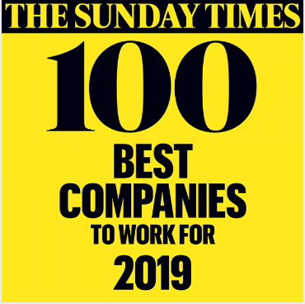
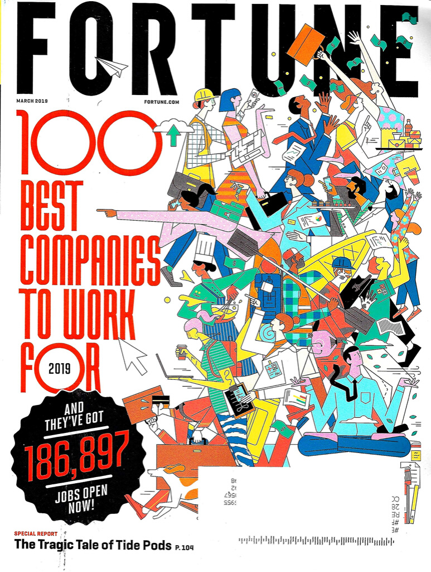
EMPLOYEES
Good salary payment, job security, employee benefits, paid vacation
=
Job satisfaction, good customer relations and therefore more satisfied customers, who will in many cases return
(Basariya, 2013)

Slide 8
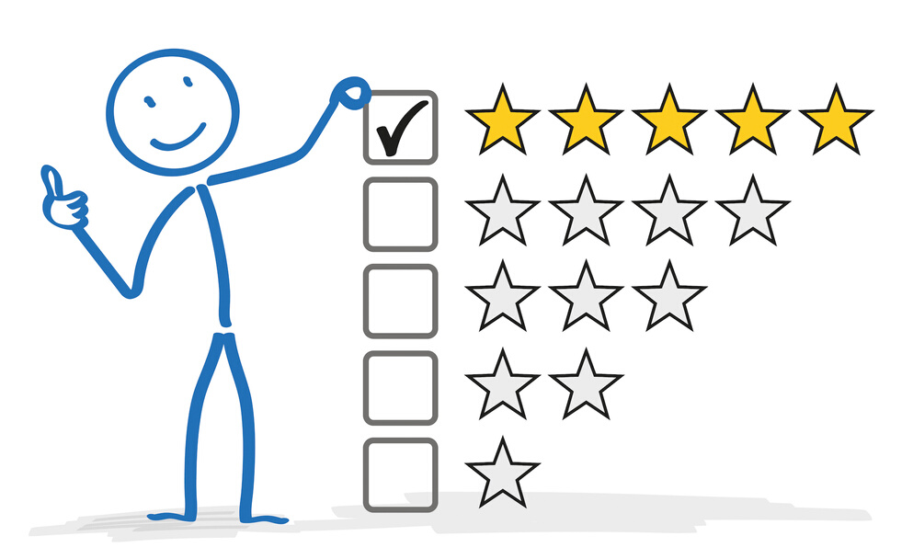
CUSTOMERS
Customers tend to go back to businesses or service providers that keep them satisfied. Even better still, they recommend the organisation to others.
(Ibojo, 2014).

Slide 9
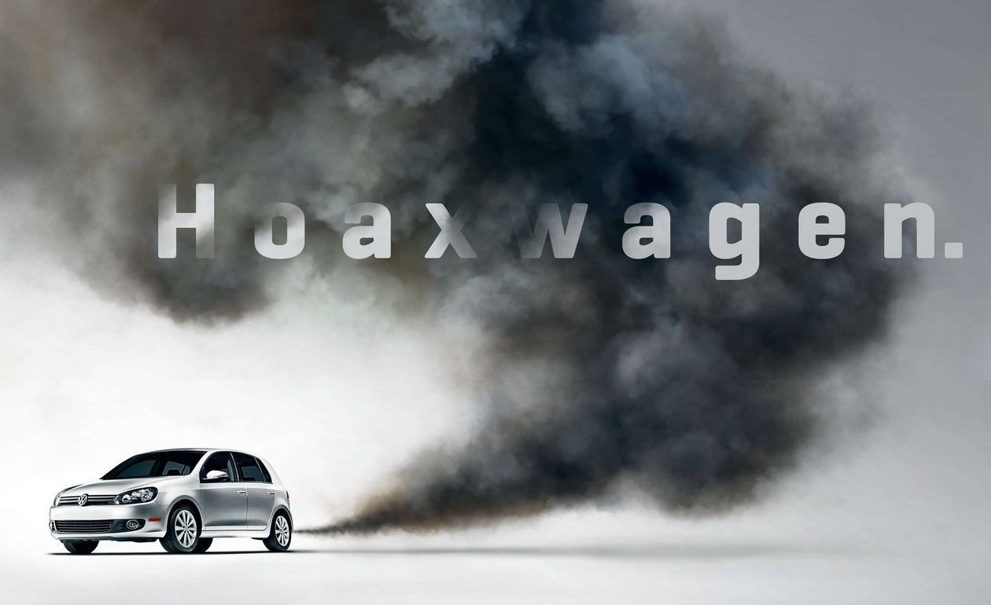
THE VOLKSWAGEN DIESELGATE SCANDAL

Slide 10
Activity 1
MARTIN WINTERKORN:
“I am shocked by the events of the past few days. I am stunned that misconduct on such a scale was possible in the
Volkswagen Group. As CEO I accept responsibility for the irregularities. I am
doing this in the interests of the company even though I am not aware of any
wrongdoing on my part. I personally am deeply sorry that we have broken the
trust of our customers and the public“.
WHO’S WHO? AND WHY?
MICHAEL HORN:
“We’ve totally screwed up. Our company was dishonest with the EPA (United State Environmental Protection Agency) and the California Air Resources Board and with all of you“.

Slide 11
VW TIMELINE
Aug 2015
First signs of being ready to come clean.
Sep 2015
Suspend head of brand development and the head of R&D.
Hire law firm for independent investigation.
Feb 2016
Hire ex-FBI director and former German constitutional judge.
Sep 2019
Mass lawsuit opens in Germany against the VW group.

Slide 12
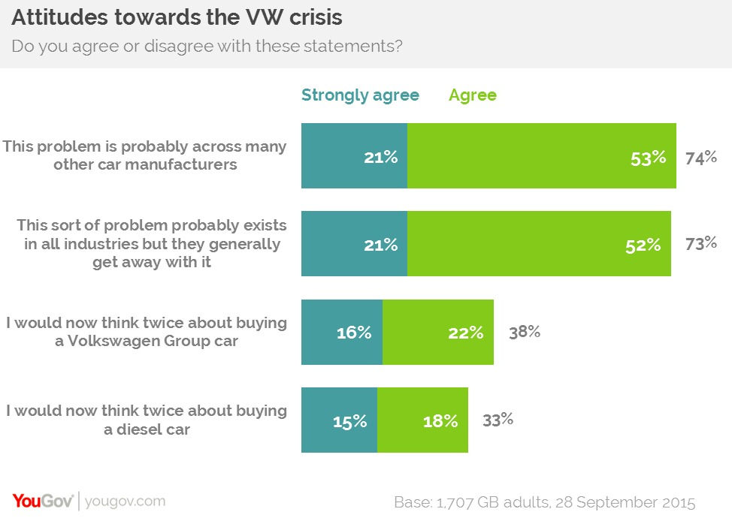
IMPACT FOR OTHER COMPANIES
Figure 1

Slide 13
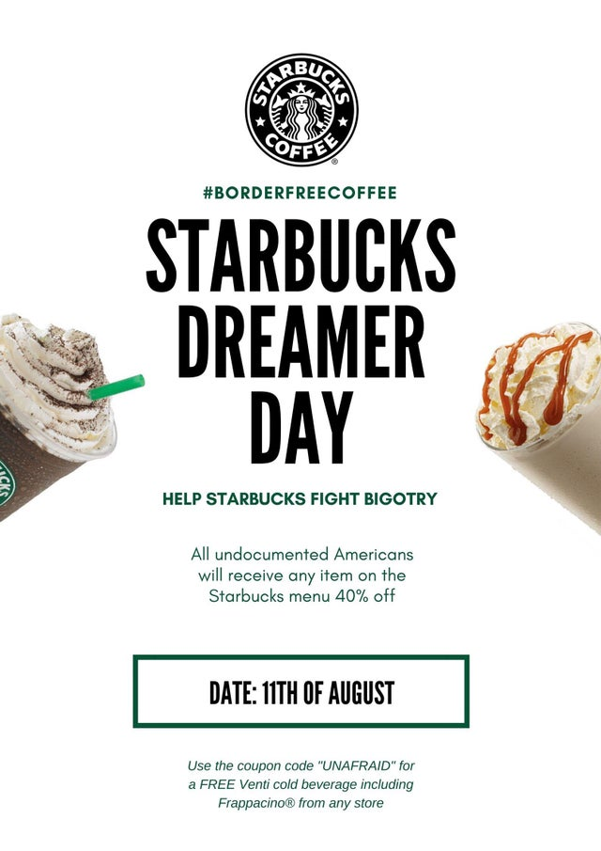
"THE BEST DIALOGUE STARTS OVER A CUP OF COFFEE, AND WE’D LIKE TO BUY YOU ONE"

Slide 14
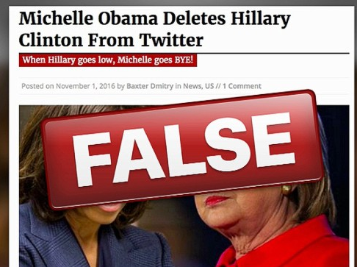
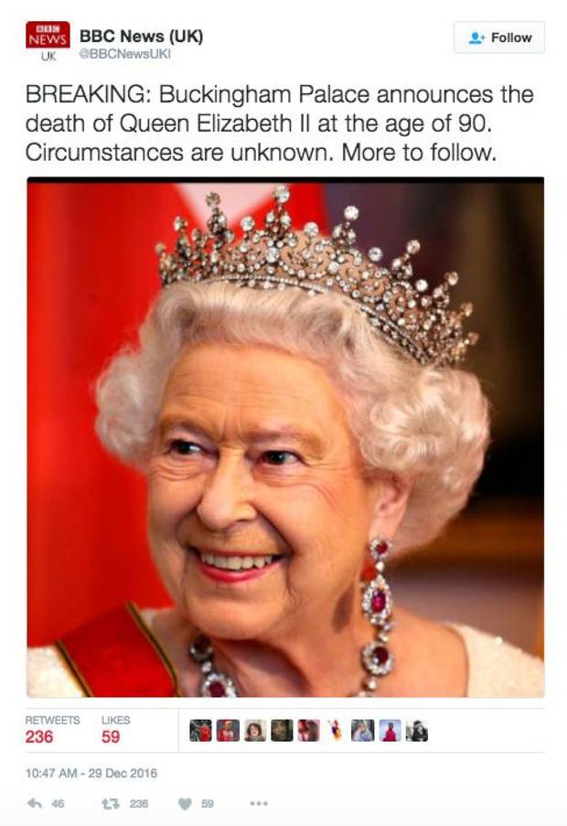
WHICH IS THE POWER
OF A FAKE NEWS?
AROUSE EMOTIONS
IMPRESS
Packaged to be more original and "new"
Leverages strong human emotions
POPULAR
Focus on popular topics

Slide 15
70%
A "FAKE" IS 70% MORE LIKELY TO BE RETWEETED THAN A "TRUE".
X6
A FAKE STORY REACHES THE FIRST 1500 USERS AT A RATE SIX
TIMES FASTER THAN A REAL NEWS.
(MIT - Boston)

Slide 16
= DECEPTIVE PRACTICE OF PRESENTING AN ORCHESTRATED MARKETING OR PR CAMPAIGN TO MAKE IT APPEAR AS ORIGINATES FROM AND IS SUPPORTED BY GRASSROOTS PARTICIPANTS
ORIGIN OF THE NAME
Name of a artficial grass company.
Antonym of grassroots (consensus rooted
in a community for a long time)

Slide 17
IS ASTROTURF WORTH THE RISK?
BEING CAUGHT ASTROTURFING MEANS DISRUPTING YOUR OWN REPUTATION, A LOSS OF TRUST BY STAKEHOLDERS AND...
...PLUS IT IS ILLEGAL IN MANY STATES.

Slide 18
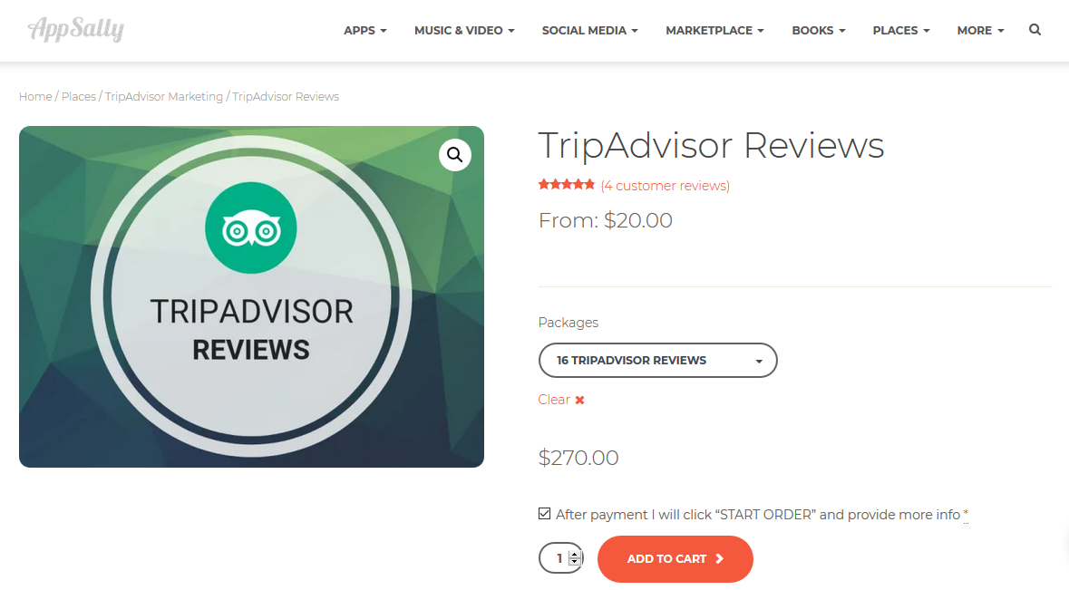
SINCE 2015, TRIPADVISOR IS FIGHTING AGAINST FAKE REVIEWS
BUT…
YOU CAN BUY THEM!

Slide 19
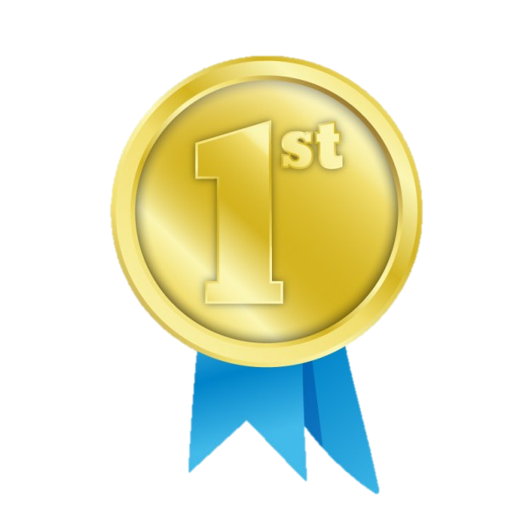
FOR THE 1ST TIME
THE OWNER OF PROMOSALENTO
WAS SENTENCED
TO 9 MONTHS OF JAIL
BECAUSE OF SELLING FAKE REVIEWS

Slide 20
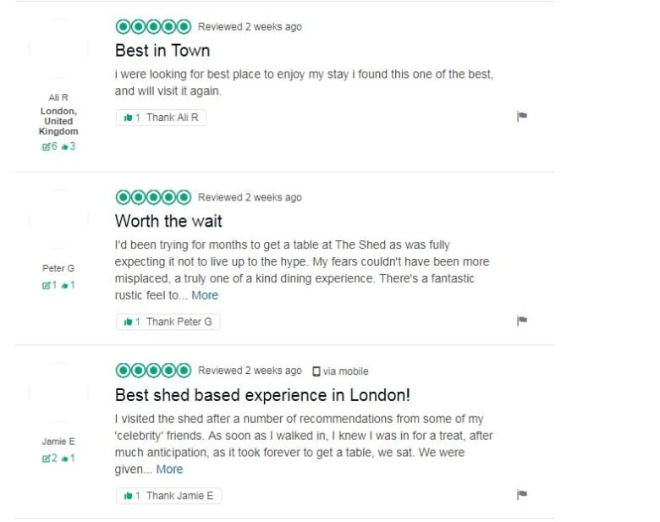
THE SHED AT DULWICH
WHAT IF ONE OF THE TOP RANKED RESTAURANTS IN LONDON DOESN’T EXIST?
Did these events affect only the business reputation or also the reputation of TripAdvisor?

Slide 21
Measuring Reputation

Slide 22
Meta reputation vs Grande reputation
Valuable intangible asset
Multiple Methodologies
Academic vs
Practioner

Slide 23
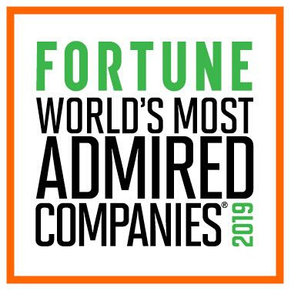
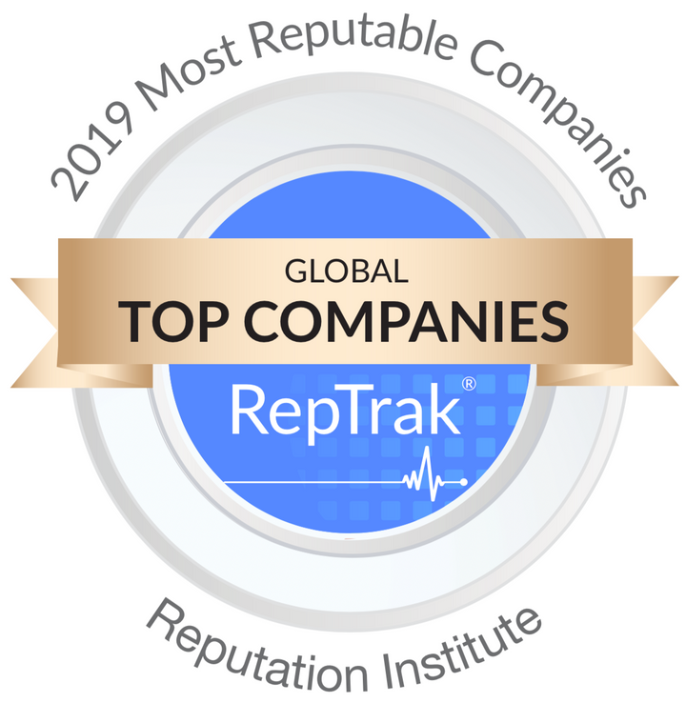
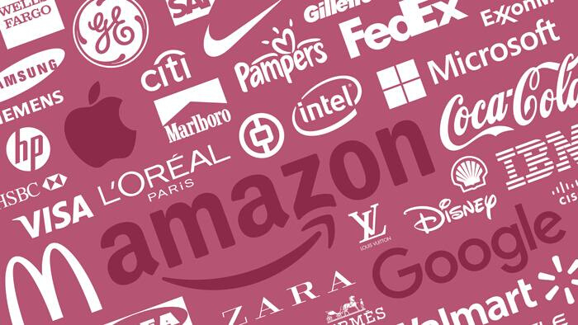
MULTIPLE METHODOLGIES

Slide 24
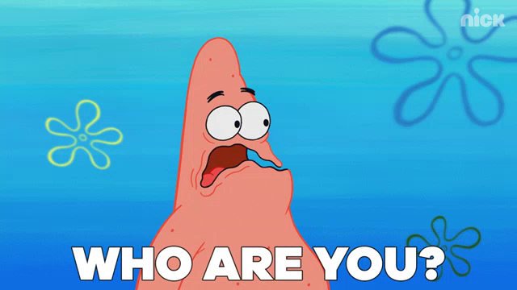
Meta
Grande

Slide 25
REPUTATION AS A 'VALUABLE INTANGIBLE ASSET'
Corporate Reputation is a ‘valuable intangible asset’ and although this ‘enhances its role in creating sustainable competitive advantage it also hinders its measurement’ (Dowling and Gardberg, 2012)
Intangible- ‘Impossible to touch, to describe exactly , or to give an exact value’ (Cambridge Dictionary, 2019)

Slide 26
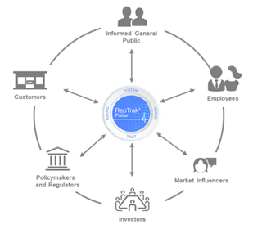
HOW TO MEASURE REPUTATION
ACCORDING TO THE REPUTATION INSTITUTE...
"The degree of admiration, trust, good feeling and overall esteem that stakeholders hold about organisations."
(Tench and Yeomans, 2014)
Figure 2
Notes:
mmm

Slide 27
Are your leaders representative of your company values?
Can your company be trusted to do the right thing, even when no one is looking?
How does your company align with social values?
Are your products and service of high quality?
Do you provide a healthy work environment for your employees?
Is your company forward thinking and creative?
Are you performing well financially?

Slide 28
Activity 2
CUSTOMERS CHOOSE PRODUCTS ON REPUTATION BASES
RATE THE REPUTATION OF THESE COMPANIES.
Country of origin:
Sector:
Germany
Technology
US
Retail
France
Hair and Beauty

Slide 29
•The company took a €2.3bn hit in 2006 due to unethical behaviour
•CEO Mr Kaeser is facing an open revolt from investors and constant predictions from the press that he will stand down from his role early.
•Top 5 Top CEOs 2019 (Glassdoor Awards)
•Top 50 Best Places to Work 2019 (Glassdoor Awards)
•Senator Bernie Sanders, in US, has gone as far as to introduce legislation aimed at forcing huge companies such as Amazon to pay their employees better wages.
•Workers protest warehouse working conditions both in the UK and the US donning t-shirts reading ‘WE ARE NOT ROBOTS’.
•Average 337 new workers every day
•Some of their past strategies and campaigns have raised eyebrows in the past few years.
•The L'Oreal haircare campaign, which purported to celebrate diversity, quickly made headlines for featuring Amena Khan, hijabi model, in a hair product advertisement.
•Fell off both the Worlds and Americas best employers list in 2018.
•Still regarded by Forbes as one of the best employers for women and diversity
Activity 2

Slide 30
Activity 2
1
2
3
SOLUTION
(Valet, Forbes 2019)
1
2
3
(Financial Times, 2019)
1
2
3
(Global CR RepTrak 100, 2019)

Slide 31
THE TEAM SAYS THANKS FOR LISTENING
DAISY DUNN
ISABELLA NOVATI
JENNIFER RAFFERTY
MARYAM UMAR
EMMA DIEDERIK

Slide 32
DEFINITION AND MEASURING REP
Cornelissen, J. (2014) Corporate Communication, A guide to Theory and Practice. 4th ed. London: SAGE Publications Ltd.
Barnett, M & Pollock, T. (2012) The Oxford Handbook of Corporate Reputation. 1st ed. Oxford: Oxford University Press.
Cambridge Dictionary (2019) Available from: <https://dictionary.cambridge.org/dictionary/english/intangible> [Accessed 27 November 2019]
Jin, B. and Woo, H. (2015) Apparel firms’ corporate social responsibility communications: Cases of six firms from an institutional theory perspective. Emerald Insight, 28 (1) August, pp. 37-55.
Fransden, F. and Johansen, W. (2014) Corporate image, reputation and identity. In: Tench, R. and Yeomans, L. eds. Exploring Public. Harlow: Pearson Education Limited, pp. 182-193.
Winter, D. (2019). Top 100 Brands 2019: the full ranking. Available from: < https://www.ft.com/content/3a3419f4-78b1-11e9-be7d-6d846537acab> [Accessed 2nd December]
Gonçalves, A. (2019). The Top 100 Companies With the best CSR Reputation. Available: https://youmatter.world/en/top-100-companies-best-csr-reputation2019-28108/. [Accessed 2nd December].
Valet, V. (2019). The World's Most Reputable Companies 2019. Available from: <https://www.forbes.com/sites/vickyvalet/2019/03/07/the-worlds-most-reputable-companies-2019/#1198156813b6 >. [Accessed 2nd December].
REFERENCES
STAKEHOLDER AND STAKEHOLDER IMPACT
Anon (2010) Stakeholder Influence [online] Available from < https://stakeholdermap.com/stakeholder-influence.html > [Accessed 16th November 2019]
Gartenstein D (2018) The Importance of Stakeholders [online] Available from < https://bizfluent.com/info-8704286-importance-stakeholders.html > [Accessed 18th November 2019]
Han K (2013) Reputation Management Presentation [online] Available from <https://prezi.com/jam12k1_srpc/reputation-management-presentation > [Accessed 18th November 2019]
Kelly D (2019) Stakeholders [online] Available from <https://prezi.com/f_qtnlgobxag/14-stakeholders/> [Accessed 19th November 2019]
Kokemuller N (2011) How Do Stakeholders Influence Business Activities? [online] Available from < https://smallbusiness.chron.com/stakeholders-influence-business-activities-18754.html> [Accessed 10th November 2019]
Mcgrath S.K, Whitty S.J (2017) Stakeholder Defined[online] Available from< https://www.emerald.com/insight/content/doi/10.1108/IJMPB-12-2016-0097/full/html > [Accessed 20 November 2019]
Pudota, A. (2017). Stakeholders and How They Affect Your Business - Tech Featured. [online] Tech Featured. Available at: <https://techfeatured.com/5903/stakeholders-and-how-they-affect-your-business > [Accessed 20 Nov. 2019].

Slide 33
VOLKSWAGEN EMISSION SCANDAL
Bryant, S. (2018) Cultural differences between USA and Germany. Country navigator [Online], 31 October. Available from: < https://countrynavigator.com/blog/cultural-intelligence/german/> [Accessed 20 November 2019].
Schultz, E. (2017) Thinking New: Inside Volkswagen’s Plan To Become Relevant Again. AdAge [Online], 11 January. Available from: <https://adage.com/article/cmo-strategy/thinking-vw-s-u-s-marketing-chief-comeback-plan/307469> [Accessed 27 November 2019].
Flaming, C. (2015) Volkswagen diesel scandal threatens to ruin its credibility and value. Los Angeles Times [Online], 22 September. Available from: <https://www.latimes.com/business/autos/la-fi-hy-vw-diesel-20150923-story.html> [Accessed 14 November 2019]
.Gardner, T., Lienert, P. and Morgan, D. (2015) After year of stonewalling, Volkswagen stunned U.S. regulators with confession. Reuters [Online], 24 September. Available from: < https://www.reuters.com/article/us-usa-volkswagen-deception-insight/after-year-of-stonewalling-volkswagen-stunned-u-s-regulators-with-confession-idUSKCN0RO2IP20150924?feedType=RSS&feedName=businessNews> [Accessed 14 November 2019].
Jolly, J. (2019) Volkswagen emissions scandal: mass lawsuit opens in Germany. The Guardian [Online], 30 September. Available from: <https://www.theguardian.com/business/2019/sep/30/volkswagen-emissions-scandal-mass-lawsuit-opens-in-germany> [Accessed 14 November 2019].
Kresge, N. and Weiss, R. (2015) Volkswagen Drops 23% After Admitting Diesel Emissions Cheat. Bloomberg [Online], 21 September. Available from: < https://www.bloomberg.com/news/articles/2015-09-21/volkswagen-drops-15-after-admitting-u-s-diesel-emissions-cheat> [Accessed 14 November 2019].
Leeds Beckett University (2019) Quote, Unquote A guide to Harvard referencing. [Online], n.d. Available from: < https://skillsforlearning.leedsbeckett.ac.uk/local/Quote_Unquote.pdf> [Accessed 14 November 2019]
Plungis, J. and Hull, D. (2015) VW’s Emissions Cheating Found by Curious Clean-Air Group. Bloomberg [Online], 20 September. Available from: <https://www.bloomberg.com/news/articles/2015-09-19/volkswagen-emissions-cheating-found-by-curious-clean-air-group> [Accessed 14 November 2019].
Volkswagen Group (2015) Video statement Prof. Dr. Martin Winterkorn [Online video], 22 September. Available from: < https://www.youtube.com/watch?v=wMPX98_H0ak> [Accessed 14 November 2019].
Verčič, D. and others (2015) Managing CEO communication and positioning : A cross-national study among corporate communication leaders. Emerald Insight, 20 (1) October, pp. 37-56.
REFERENCES

Slide 34
FAKE NEWS & ASTROTURFING 1/2
Bienkov, A. (2012) Astroturfing: What is it and why does it matter? The Guardian [Online], 8 February. Available from: < https://www.theguardian.com/commentisfree/2012/feb/08/what-is-astroturfing> [Accessed 5 November 2019]
Hachman, M. (2014) Microsoft caught ‘astroturfing’ bloggers again to promote Internet Explorer. PC World [Online], 18 June. Available from: < https://www.pcworld.com/article/2365060/microsoft-caught-astroturfing-bloggers-again-to-promote-internet-explorer.html > [Accessed 5 November 2019]
Perkins, M. (2018), Fake news: a real risk to profits and reputation. Lockton International [Online], 1 January. Available from < https://www.locktoninternational.com/gb/articles/fake-news-real-risk-profits-and-reputation > [Accessed 5 November 2019]
Marro, E. (2019), Come nasce una fake news (e perché viene cliccata più di quelle vere). Il sole 24 ore [Online], 16 March. Available from < https://www.ilsole24ore.com/art/come-nasce-fake-news-e-perche-viene-cliccata-piu-quelle-vere-ABVojVeB > [Accessed 7 November 2019]
Palmquist, M. (2019), How fake news can taint a brand’s image. Strategy Business [Online] 6 June. Available from < https://www.strategy-business.com/blog/How-fake-news-can-taint-a-brands-image?gko=76419 > [Accessed 7 November 2019]
Popper, B. (2010) Astroturfing Antitrust: How Microsoft is Crafting the Grassroots Case Against Google. CBS News [Online], 2 March. Available from: < https://www.cbsnews.com/news/astroturfing-antitrust-how-microsoft-is-crafting-the-grassroots-case-against-google/ > [Accessed 5 November 2019]
Taylor, K. (2017), Starbucks shoots down viral rumor that it's giving away free coffee to undocumented immigrants. Business Insider [Online], 7 August. Available from < https://www.businessinsider.com/fake-news-starbucks-free-coffee-to-undocumented-immigrants-2017-8?r=UK > [Accessed 5 November 2019]
Tomar, D. (n.d) Deadly Disinformation: How Drug Companies Use Astroturfing to Get Us Hooked. The Quad [Online], n.d. Available from: < https://thebestschools.org/magazine/playing-on-astroturf-wikipedias-battle-for-natural-grass/ > [Accessed 6 November 2019]
Monbiot, G. (2011). The need to protect the internet from 'astroturfing' grows ever more urgent. Available from: < https://www.theguardian.com/environment/georgemonbiot/2011/feb/23/need-to-protect-internet-from-astroturfing> [Accessed 3rd Dec 2019].
Monbiot, G. (2006). The denial industry. Available from: < https://www.theguardian.com/environment/2006/sep/19/ethicalliving.g2?INTCMP=SRCH>. [Accessed 3rd Dec 2019].
REFERENCES

Slide 35
FAKE NEWS & ASTROTURFING 2/2
PA Media, (2019) TripAdvisor is failing to stop fake hotel reviews, says Which?. The Guardian [Online], 6 September. Available from <https://www.theguardian.com/travel/2019/sep/06/tripadvisor-failing-to-stop-fake-hotel-reviews-which> [Accessed 29 November 2019]
BBC News, (2019) TripAdvisor defends itself in fake reviews row. BBC News [Online], 6 September. Available from < https://www.bbc.co.uk/news/business-49605457 > [Accessed 29 November 2019]
Simonetta B, (2018) TripAdvisor, chi scrive false recensioni e le vende va in carcere. Il Sole 24 Ore [Online], 12 September. Available from <https://www.ilsole24ore.com/art/tripadvisor-chi-scrive-false-recensioni-e-vende-va-carcere-AE6OZ4qF > [Accessed 29 November 2019]
Giuffrida A, (2018) Man jailed in Italy for selling fake TripAdvisor reviews. The Guardian [Online] 12 September. Available from < https://www.theguardian.com/world/2018/sep/12/man-jailed-italy-selling-fake-tripadvisor-reviews-promo-salento > [Accessed 29 November 2019]
CBC, (2017) How this man tricked TripAdvisor into listing his shed as London's No. 1-rated restaurant. CBC [Online] 7 December. Available from < https://www.cbc.ca/radio/asithappens/as-it-happens-thursday-edition-1.4437547/how-this-man-tricked-tripadvisor-into-listing-his-shed-as-london-s-no-1-rated-restaurant-1.4437555 > [Accessed 29 November 2019]
The Internet Law Centre (n.d.) Is it illegal in the UK to post fake online reviews? . The Internet Law Centre [Online] (n.d.). Available from <https://www.defamationagainstacompany.co.uk/is-it-illegal-in-the-uk-to-post-fake-online-reviews > [Accessed 29 November 2019]
REFERENCES
ACTIVITY
Valet, V. (2019) The World Most Reputable Companies 2019. Forbes [Online], 7 March. Available from: < https://www.forbes.com/sites/vickyvalet/2019/03/07/the-worlds-most-reputable-companies-2019/#5c73da8c13b6> [Accessed 20 November 2019]

